Slide 1
Networking for Software Developers
Lecture 6 – Part II – Summer 2024

Slide 2
Agenda
Secure Shell (SSH)

Slide 3
Secure Shell (SSH)

Slide 4
SSH
Application protocol that leverages authentication and encryption to securely operate and administer services/systems over an unsecured network
Designed as a replacement for Telnet and remote shell protocols that were insecure or used plaintext methods
Based on client–server architecture that operates over TCP/IP
Operates on Port 22 (Inbound)

Slide 5
SSH Use Cases
Support a variety of functions:
Remote access to resources
Remote execution of commands
File transfer between nodes
Deliver patches and updates
Other administrative or management tasks

Slide 6
SSH Implementation
Client
Server
SSH Client:
Establish a connection to a remote host/server
Supply credentials (e.g., username, keys, etc.)
Negotiate or specify connection details with the remote host/server
Submit commands
Etc.
SSH Server or Daemon:
Actively listening for client connections
Accept and authenticate a connection from client
Generate the appropriate environment
Process the commands from the client
Etc.

Slide 7
Note on Cryptography

Slide 8
Note on Cryptography
Symmetrical Encryption
Use one secret key for both the encryption and decryption on the client and the host
Generate the Symmetric key by using an agreed method
The client and server do not exchange or transmit the key; instead the two parties independently generate the key based on shared public pieces
Generate the key before client authentication and data transmission to ensure encrypted transmission for subsequent interactions between the client and server

Slide 9
Note on Cryptography
Asymmetrical Encryption
Use two separate keys that form a public-private key pair
Public key supports the encryption process and can be shared; Private key supports the decryption process and cannot be shared
Mathematically impossible to calculate the private key from the public key
Hashing
Generate a unique value of a fixed length for an input (of variable length)
Cannot be exploited due to one-way function design

Slide 10
SSH Continued ...

Slide 11
SSH Flow
Client
Server
Client connects to and authenticates the server
Server and client negotiate the protocol details; Generate session key and initiate symmetric encryption
Server authenticates client employing asymmetric encryption and MD5 hashing
Client submits commands to the server; Server to process/execute the commands

Slide 12
SSH Continued ...
How do we implement the SSH protocol?

Slide 13
SSH with Paramiko
Client connecting to Linux VM (AWS LightSail):
import paramiko

Slide 14
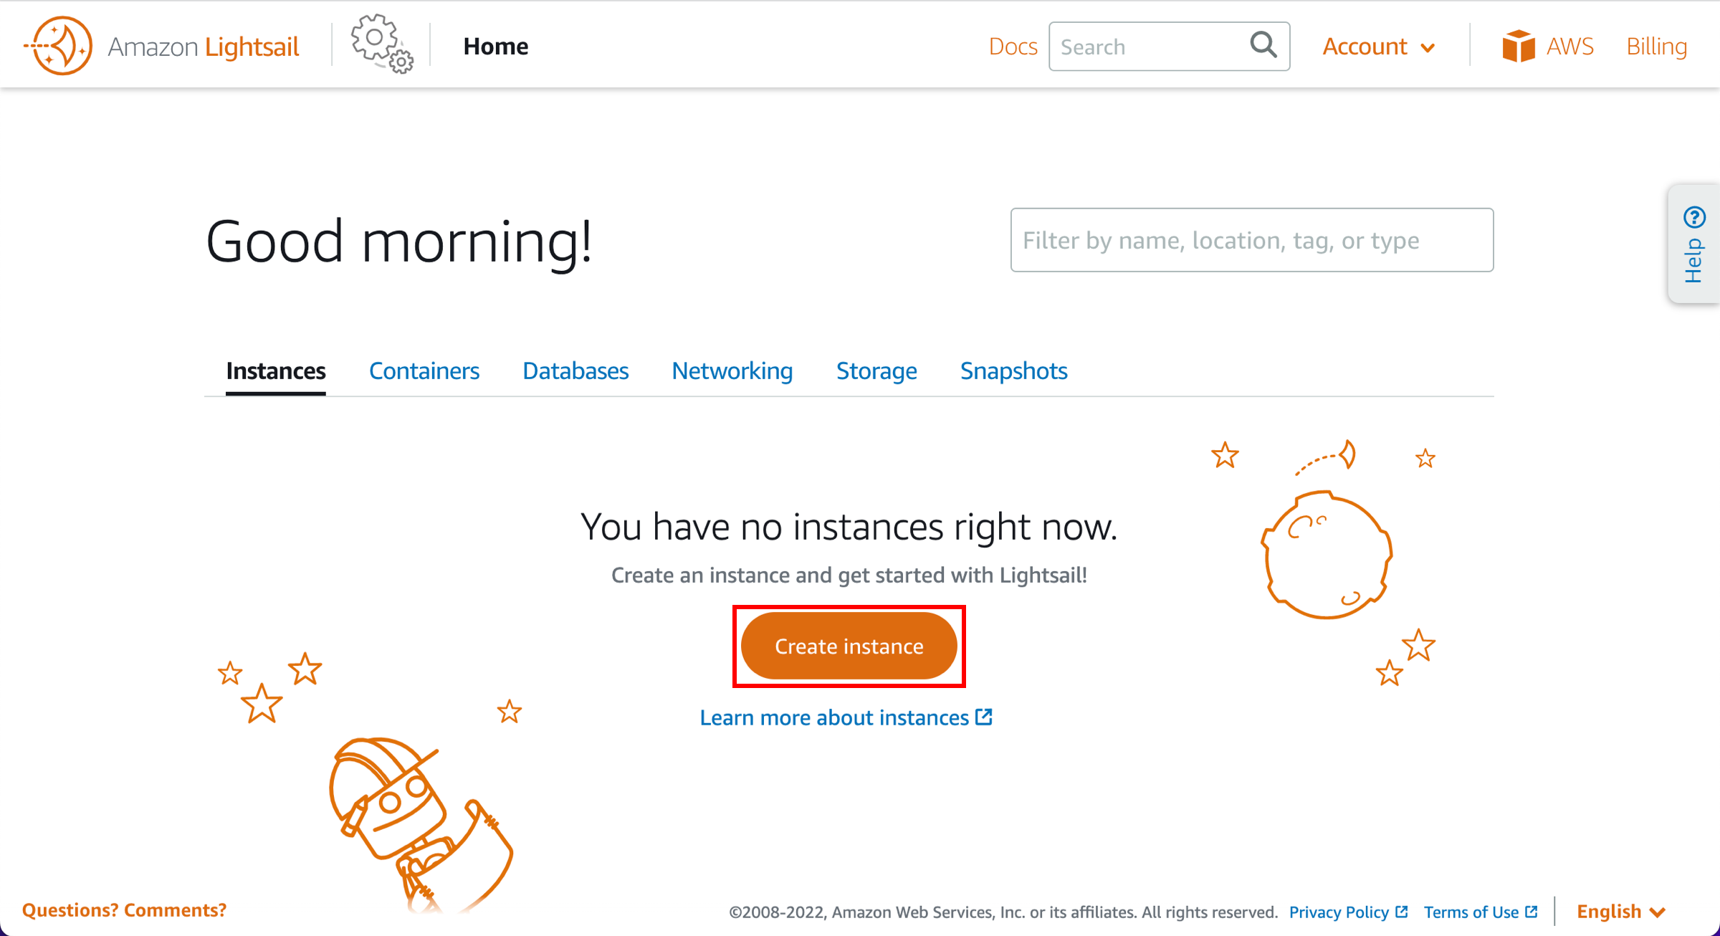
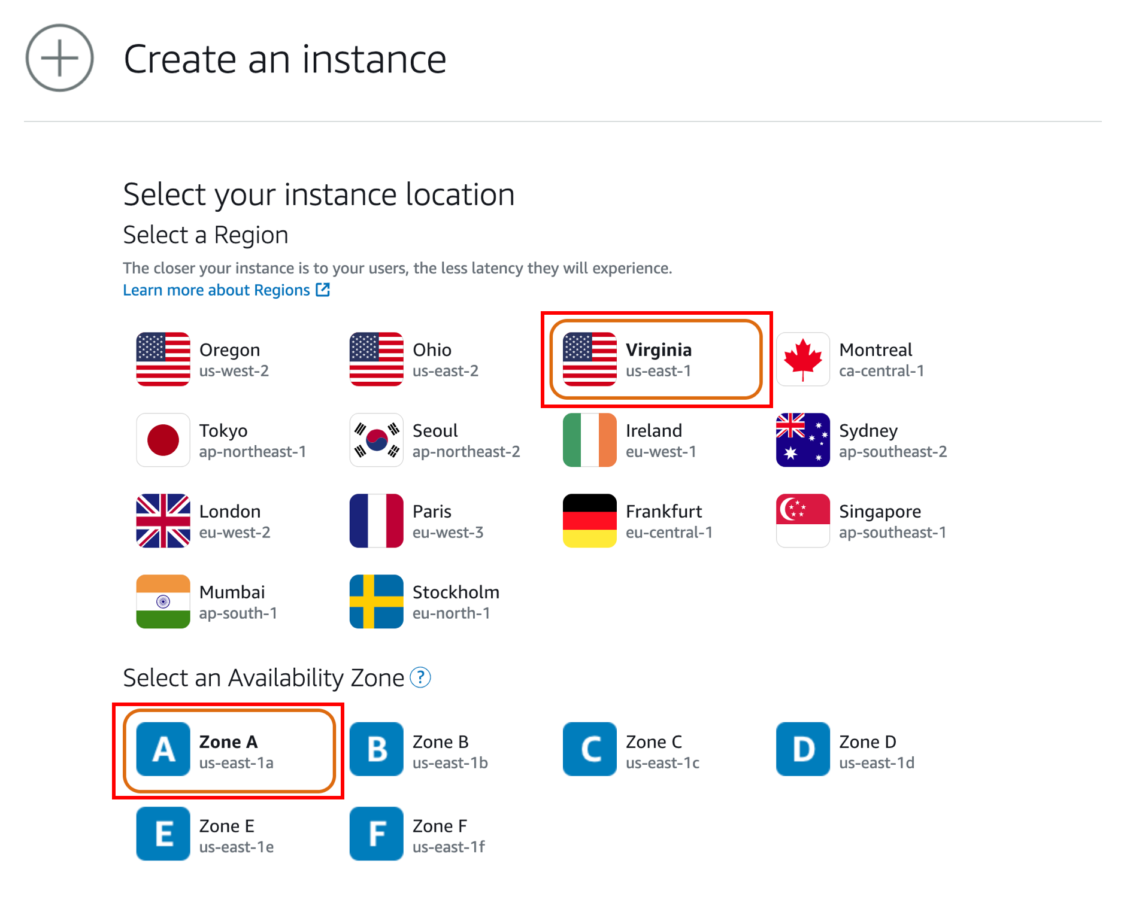
SSH with Paramiko (AWS)

Slide 15
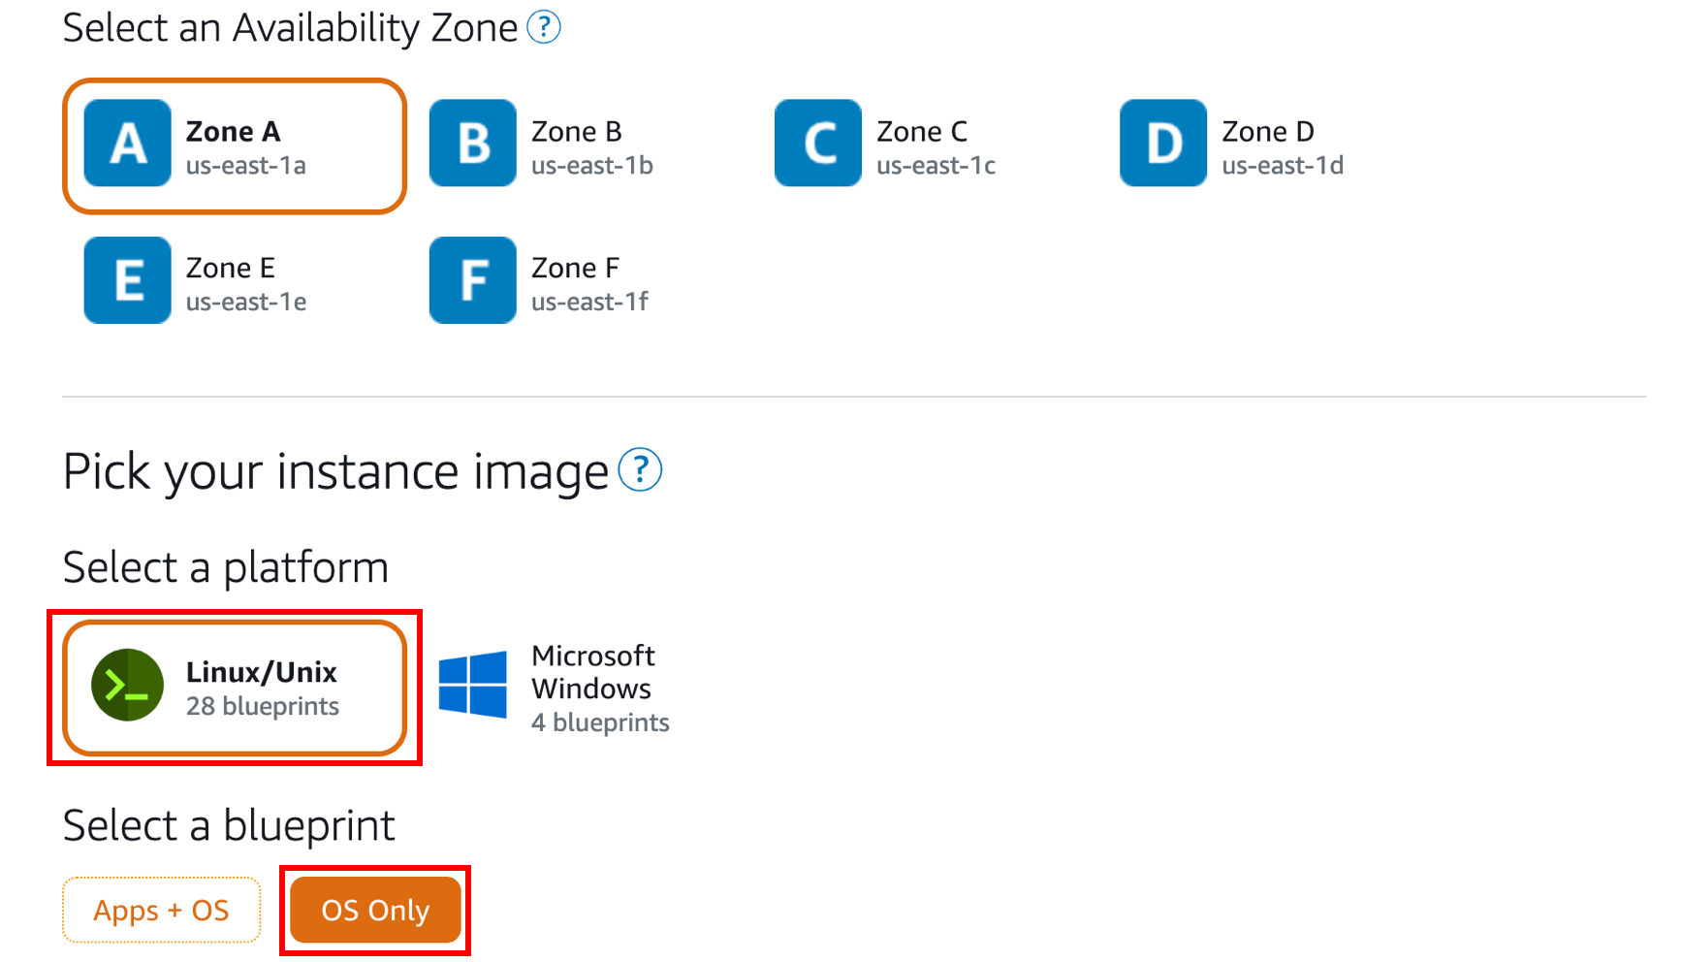
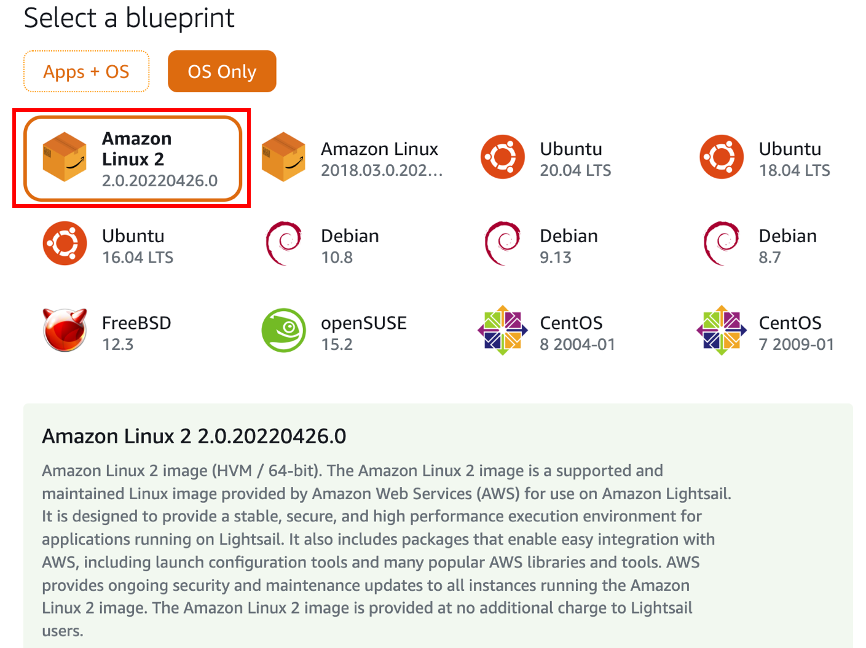
SSH with Paramiko (AWS)

Slide 16
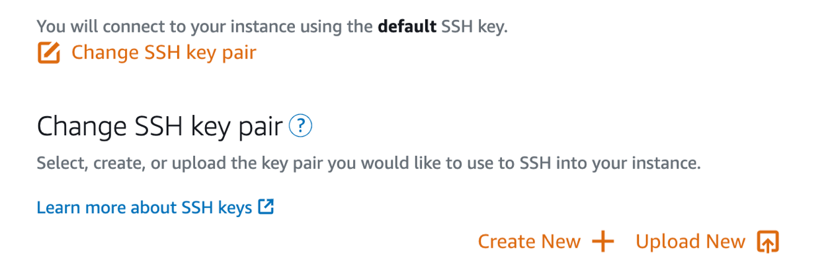
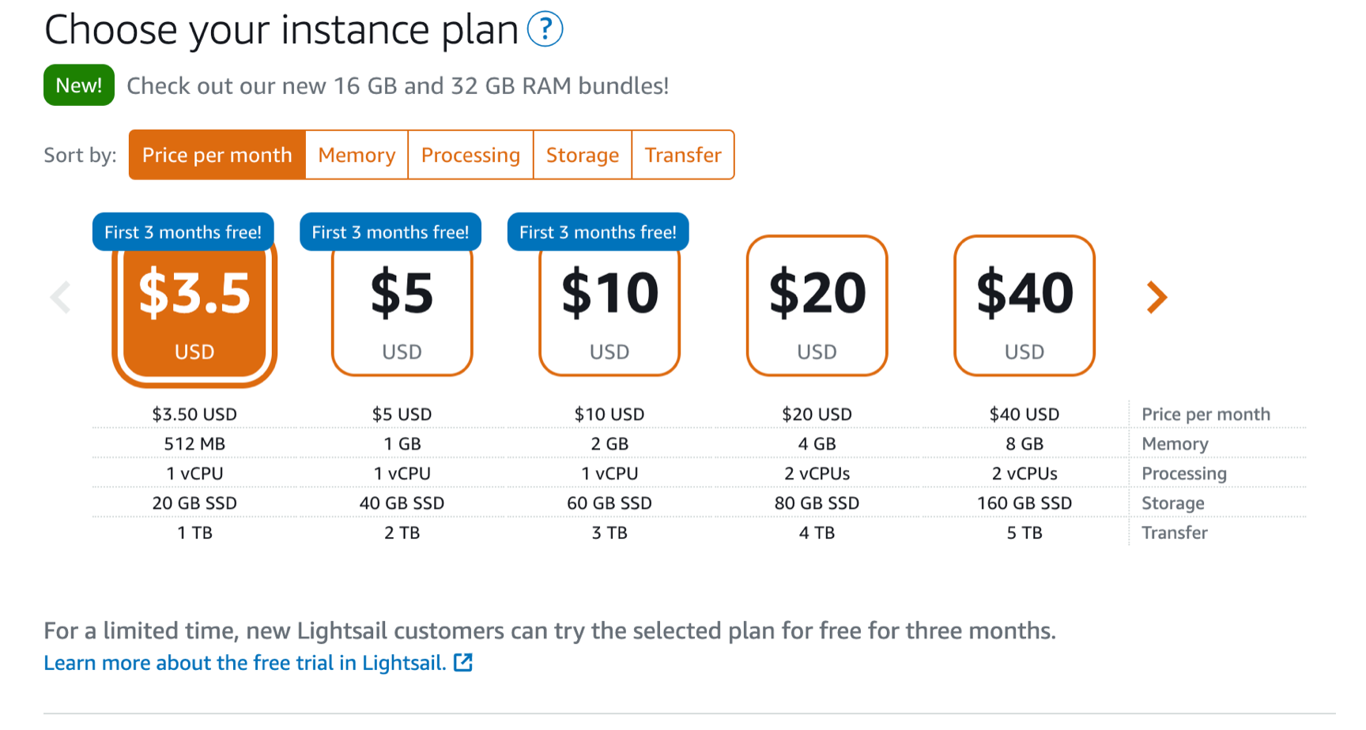
SSH with Paramiko (AWS)

Slide 17
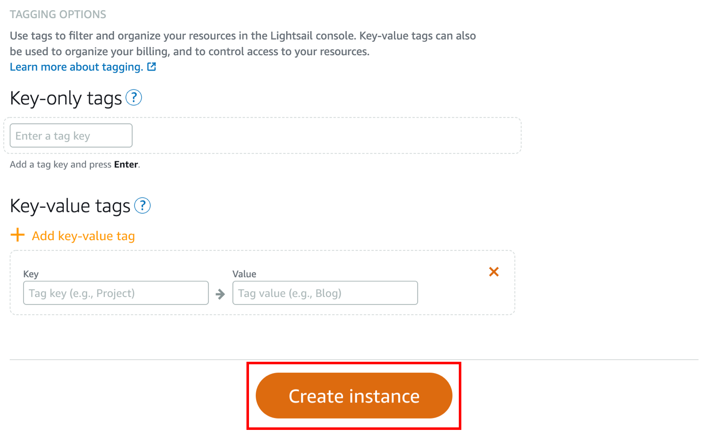
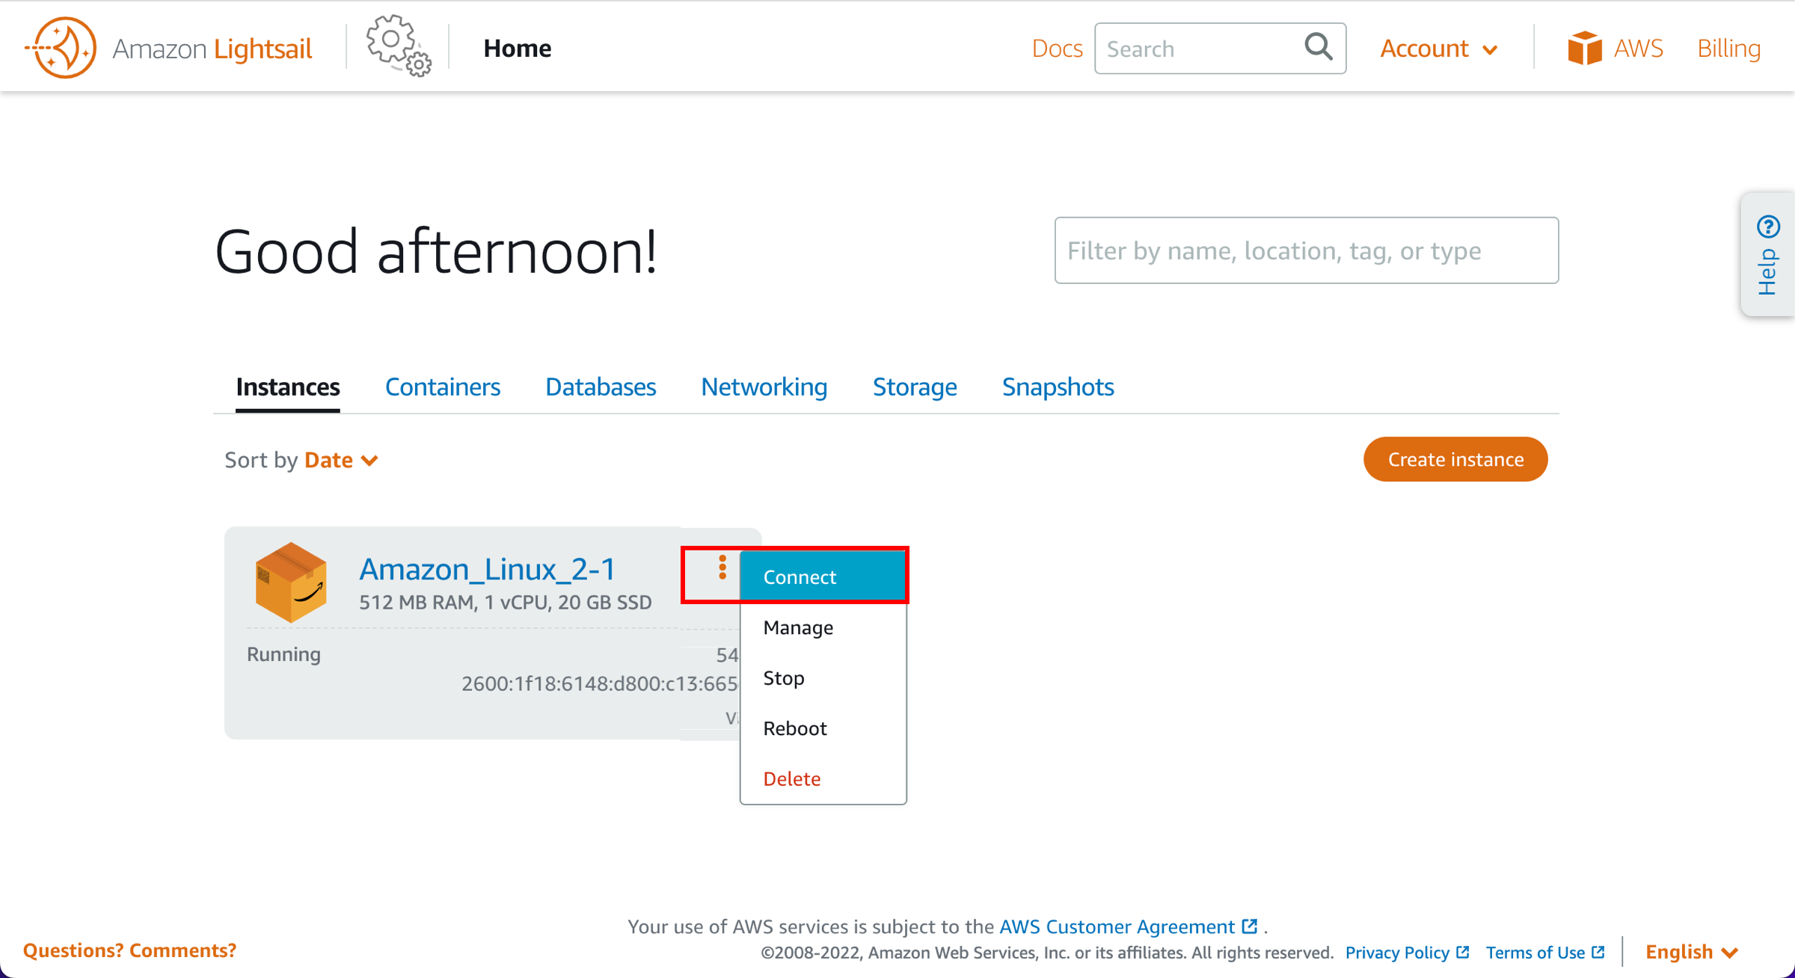
SSH with Paramiko (AWS)

Slide 18
SSH with Paramiko
Client connecting to Linux VM (AWS LightSail):
import paramiko

Slide 19
SSH with Paramiko
Client connecting to Linux VM (AWS LightSail):
import paramiko
IP = 'XX.XXX.XXX.XXX'
USERNAME = 'username'

Slide 20
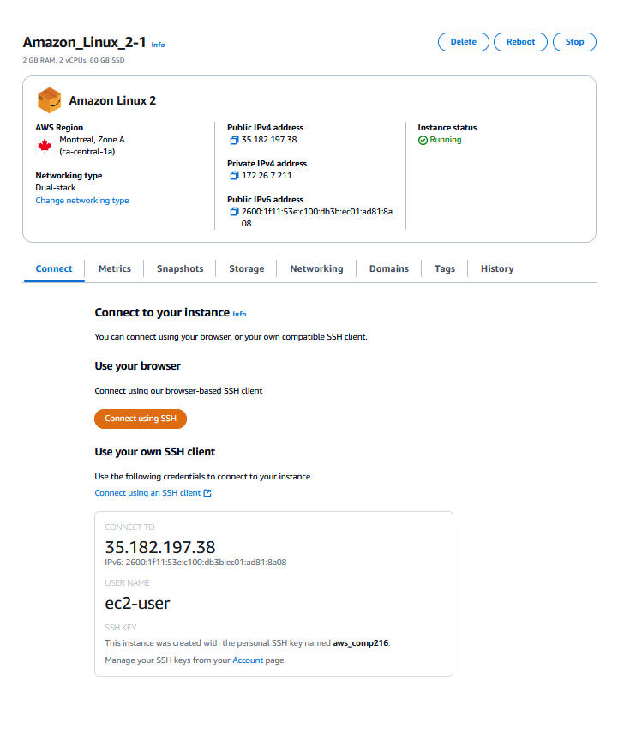
SSH with Paramiko
Client connecting to Linux VM (AWS LightSail):
import paramiko
IP = 'XX.XXX.XXX.XXX'
USERNAME = 'username'

Slide 21
SSH with Paramiko
Client connecting to Linux VM (AWS LightSail):
import paramiko
IP = 'XX.XXX.XXX.XXX'
USERNAME = 'username'

Slide 22
SSH with Paramiko
Client connecting to Linux VM (AWS LightSail):
import paramiko
PRIVATE_KEY = paramiko.RSAKey.from_private_key_file('path/privatekey.pem')
IP = 'XX.XXX.XXX.XXX'
USERNAME = 'username'

Slide 23
SSH with Paramiko
Client connecting to Linux VM (AWS LightSail):
...
ssh_client = paramiko.SSHClient()
ssh_client.load_system_host_keys()
ssh_client.set_missing_host_key_policy(paramiko.AutoAddPolicy())

Slide 24
SSH with Paramiko
Client connecting to Linux VM (AWS LightSail):
...
ssh_client.connect(hostname=IP, username=USERNAME, pkey=PRIVATE_KEY)
stdin,stdout,stderr = ssh_client.exec_command('ls -al')
for stdout_line in stdout.readlines():
print(stdout_line)
for stderr_line in stderr.readlines():
print(stderr_line)

Slide 25
SSH with Paramiko
Output:
>>> total 12
drwx------ 3 ec2-user ec2-user 74 Jul 6 19:43 .
drwxr-xr-x 3 root root 22 Jul 6 19:43 ..
-rw-r--r-- 1 ec2-user ec2-user 18 Jul 15 2020 .bash_logout
-rw-r--r-- 1 ec2-user ec2-user 193 Jul 15 2020 .bash_profile
-rw-r--r-- 1 ec2-user ec2-user 231 Jul 15 2020 .bashrc
drwx------ 2 ec2-user ec2-user 29 Jul 6 19:43 .ssh

Slide 26
SSH with Paramiko
Paramiko module has other objects and methods:
Invoke shell – start interactive shell session
Open SFTP – create session object for file transfers between client and server
Etc.

